Slide 1
Proposal for Indoor Building Solutions
Team Members:
Mennatullah Ebrahem Mohamed “Team leader’’
Yara Khaled Hassan
Sama Essam Eldin Hassam
Mohamed Ahmed Khedr
Salma Mohamed El Sayed
Project Supervisor: Dr. Mohamed Amr Mukhtar
This proposal is developed by students from the Faculty of Engineering, Electronic & Communication Department, Alexandria University.

Slide 2
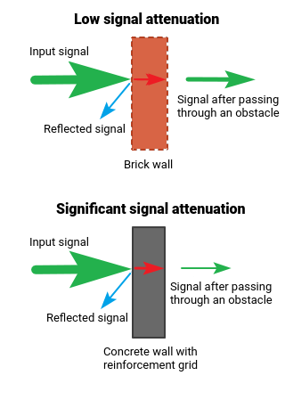
In Building Solutions
Introduction
This project aims to address the challenges associated with using outdoor RF signals within buildings. Outdoor RF signals often face significant losses due to the distance between the source and the destination, as well as attenuation caused by concrete or brick walls. These factors result in weakened signals inside buildings, leading to poor connectivity. Additionally, the increasing number of users exacerbates capacity issues (80% of calls and data sessions are initiated indoors initiated indoors). To overcome these challenges, we propose the implementation of In Building Solutions (IBS)

Slide 3
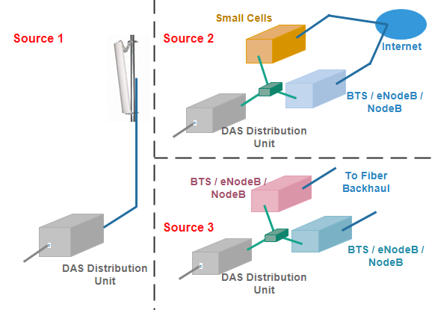
Project overview
DAS is a network of antennas that send and receive cellular signals on a carrier’s licensed frequency.
The idea is to split the transmitted power among several antenna elements, separated in space so as to provide coverage over the same area as a single antenna but with reduced total power and improved reliability. A single antenna radiating at high power is replaced by a group of low-power antennas to cover the same area.
All DAS systems require two things:
1.Source Signal: This refers to the process of transmitting the external signal into the building.
2.Distribution Antenna System (DAS): This component involves the network setup within the building to ensure effective distribution of the signal.

Slide 4
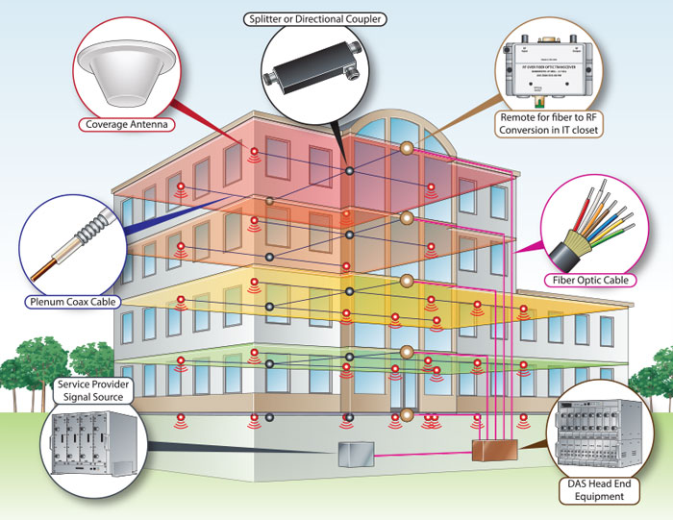
3 Major Parts of In-Building Wireless Systems
Signal Source A signal source is necessary to generate a signal within a building. These signals can originate directly from the provider’s core network or an off-air signal from a donor site, such as a cell tower.
Central processing point
The central processing point regulates the signal to the areas in need of better coverage. Depending on the type of IBW, some network equipment relays signal while others amplify the signal.
Distribution point
The distribution unit is generally a set of indoor antennas that broadcast the signal inside.

Slide 5
ACTIVE DAS OR PASSIVE DAS?
Active DAS (Distributed Antenna System):
Active DAS uses active components, such as amplifiers and signal processors, to enhance and distribute cellular signals throughout a building or area.
How it works: It works by receiving cellular signals, amplifying them, and then redistributing them via a network of antennas positioned strategically across the building. This setup helps in compensating for signal losses over long distances.
Benefits: Active DAS can provide more consistent and reliable coverage across large areas, as the active components can compensate for signal losses over long cable runs.
Passive DAS (Distributed Antenna System):
Passive DAS relies on passive elements like coaxial cables, splitters, and combiners to distribute cellular signals without amplification.
How it works: Distributes signals through passive components to antennas without amplification.
Benefits: Passive DAS tends to be simpler and less expensive to deploy compared to Active DAS. It is often used in smaller buildings or areas where the coverage requirements are not as extensive.
the choice between Active DAS and Passive DAS depends on factors such as the size of the area needing coverage, the complexity of the building structure, and the desired level of signal enhancement. Active DAS offers more flexibility and performance but at a higher cost, while Passive DAS is simpler and more cost-effective for smaller-scale deployments

Slide 6

Project objectives
Coverage: ensure that the signal from an external source is effectively and uniformly distributed throughout the indoor environment. Capacity: handle many users and data traffic simultaneously within a building for a high-quality service. Quality: ensure excellent speech quality and uninterrupted network access throughout the entire building.
Security: Ensuring only authorized personnel can access restricted areas, preventing unauthorized entry.

Slide 7


How can iBwave Design
help you?

Slide 8


Accelerate productivity, grow revenues
Components Database (over 37,000 parts and counting)
Network Design Automation
Floor plan importing

Slide 9
Advanced RF Propagation
Capacity Analysis
Automatic Error Checking
Output Maps and Compliancy Reports
Ensure high-quality

Slide 10
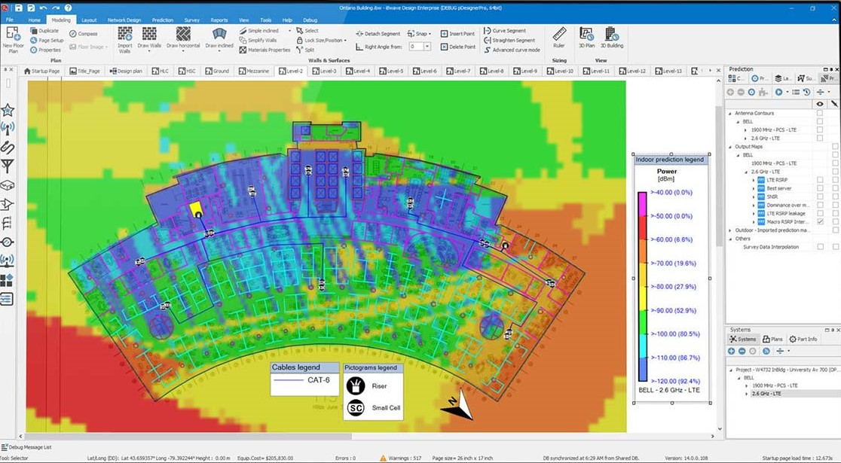

Slide 11
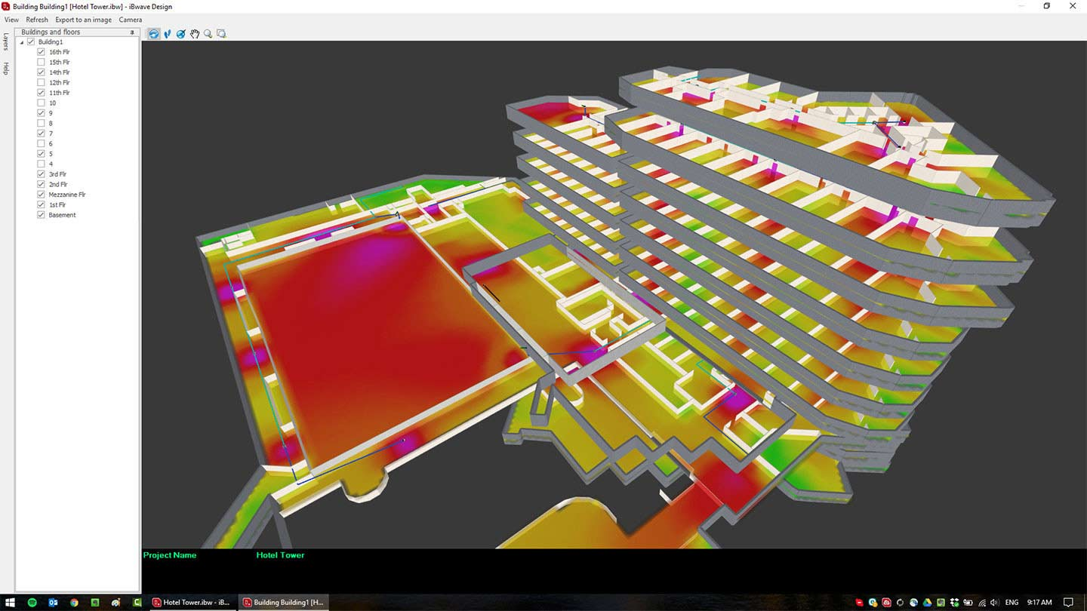

Slide 12

Eventum solutions a pioneer in telecommunications and IT services
we have been closely following Eventum solution
- founded in 2009 , based in Alexandria , Egypt
- Expert provider of telecommunications , IT services and IBS
- pioneer in High-performance network infrastructure and Software development
- Eventum team is fully trained and offers extensive support for client success.
- Eventum has pioneering projects in IBS inside and outside EYGPT
- Eventum has teams that work with clients outside Egypt north America team , NEMA region team , Asia-Pacific Team
→ Eventum has an academy teaching IBS design and iBwave to whom have knowledge in wireless communication
Eventum's partners
- CommScope
- Eventum offers top CommScope services.
- got solutions for Distributed coverage ,Outdoor macro-cell sites , Small-cell implementations , Backhaul capabilities
- Delivers advanced wireless solutions to meet growing data needs.
- Riverbed
- Focuses on Performance Management, going beyond basic WAN optimization.
- Helps improve operational efficiency and leverage benefits of cloud storage.

Slide 13

Our expectations from Eventum
Software support (access to iBwave software)
- we would be incredibly grateful if you could provide us with a complimentary version of the iBwave
- Essential for project success due to its specialized tools for designing in building wireless network
Mentorship and Guidance
- we seek your assistance in guiding us through the project and sharing your valuable insights
- we are flexible to receiving this support either online or at your company’s premises depending on what suits you
Benefits of sponsorship
- Achieve project goals and enhance learning
- strengthen relationship between Eventum and us

Slide 14

Contact us
Dr. Mohamed Amr Mukhtar Email: amromokhtar61@gmail.com Phone: 01129698688
Feel free to contact us on 01278549525 or 01153047221
Or contact es-menatallah.ibrahim2025@alexu.edu.eg
If you require any further information

